Slide 1


ARE DISCOUNTS BENEFICIAL OR NOT?
Prachi, Justin, Elyesa

Slide 2
MAIN QUESTIONS
Do massive discounts affect order quantity and consequently lead to revenue growth?
Are discounts on special product categories better suited for revenue growth?
Do seasonal discounts affect order quantity and revenue growth?
Do quarterly discounts lead to revenue growth in the long run?

Slide 3
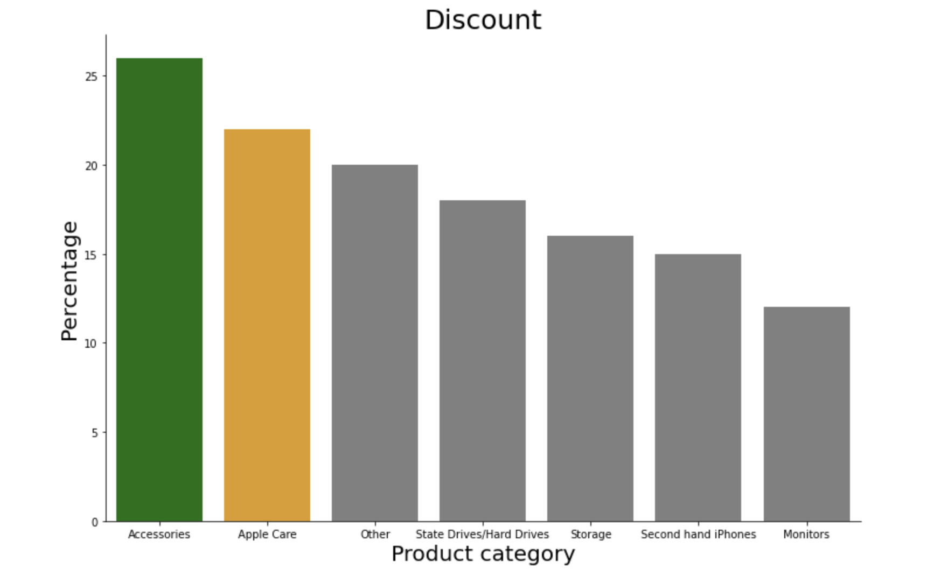
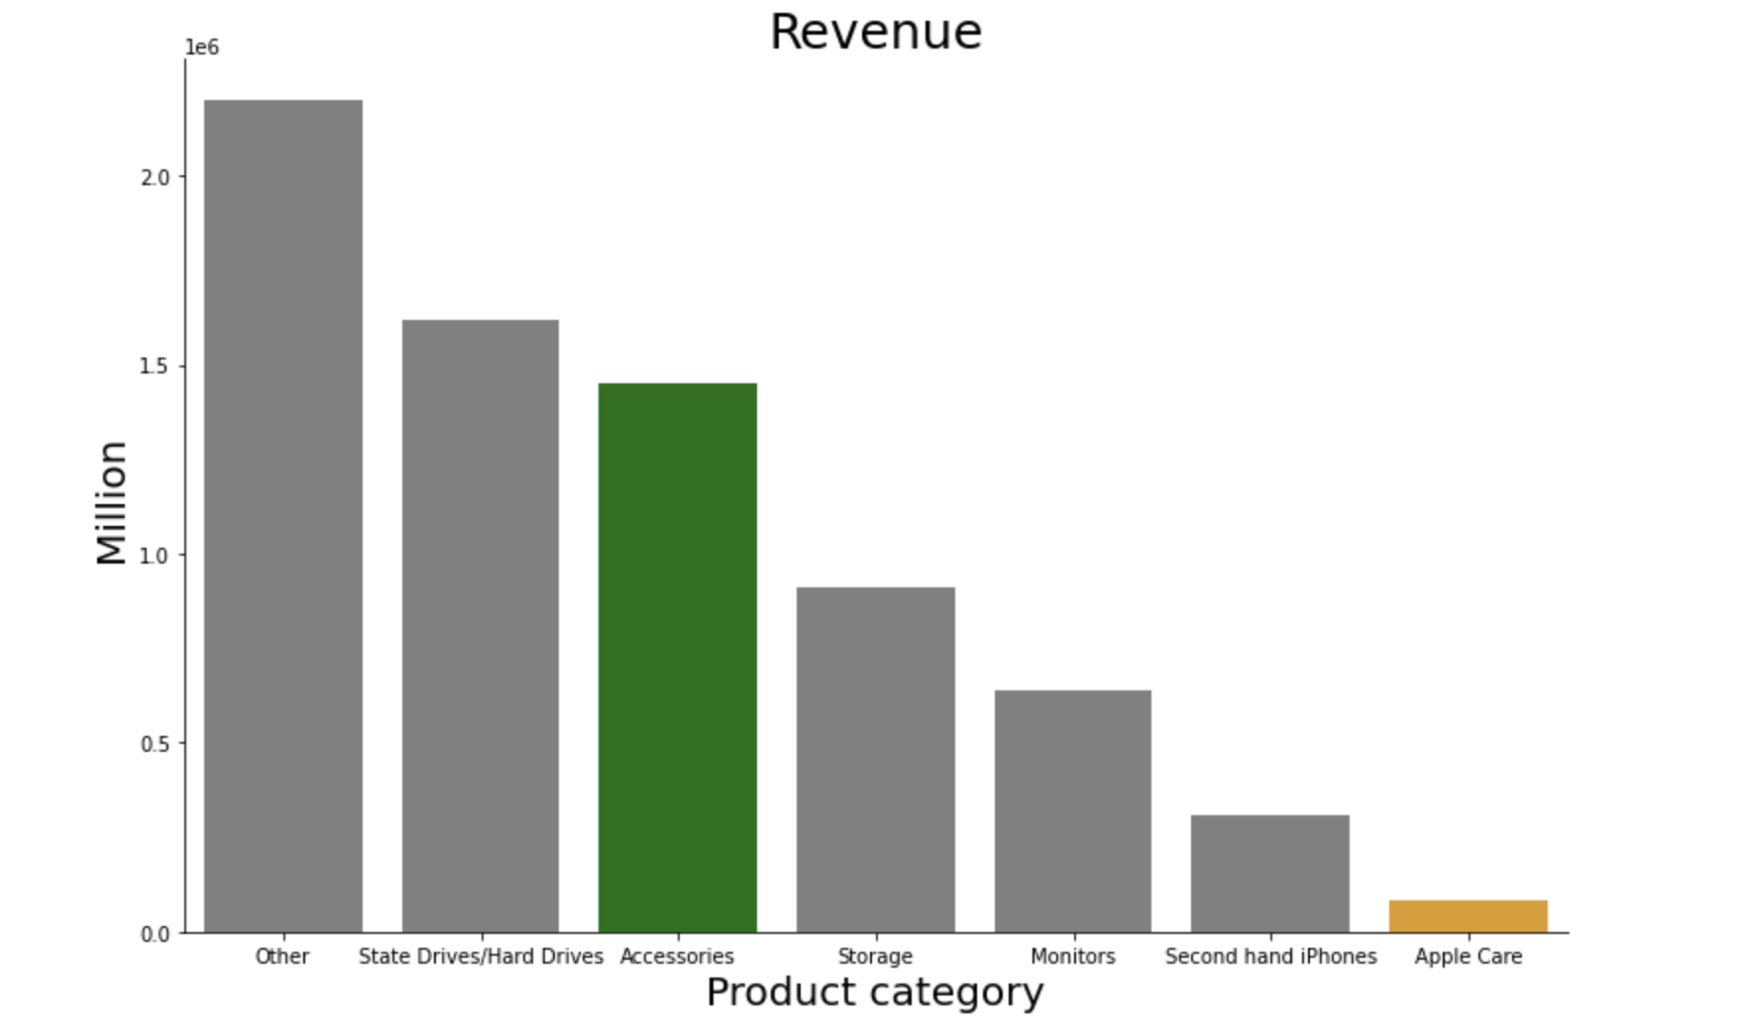
Discounts on special product categories are not better suited for revenue growth!
Notes:
Product Category distribution:
The 6 largest product categories holding 78.4% of all products available in our datasets and rest 21.6% we are considering as ‘Other’.
‘Accessories’ contains USB cables, Phone cases, Batteries, Headphones, Apple Pencil and so on.

Slide 4
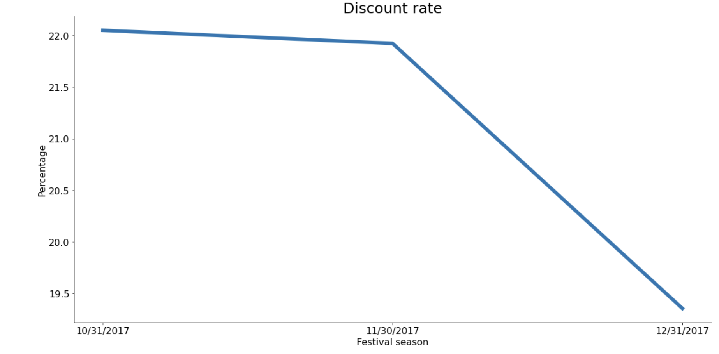
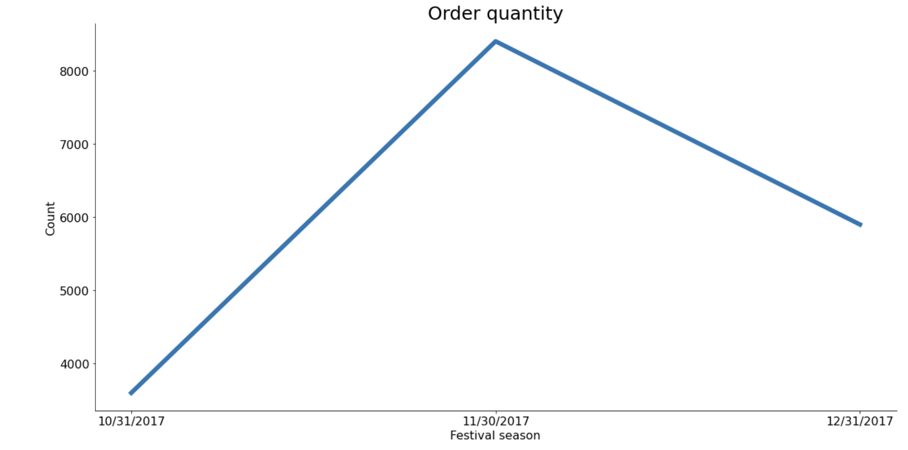
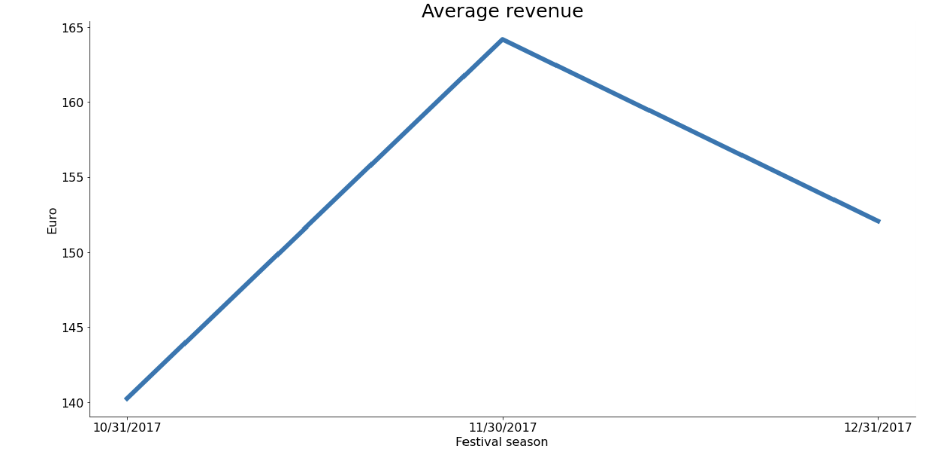
Seasonal discounts do not affect order quantity and average revenue!

Slide 5
CONCLUSION
 | Order quantity | Revenue | Discount rate
2017.Q1 ~ 2017.Q2 | - 34% | + 29% | - 27%
2017.Q2 ~ 2017.Q3 | + 61% | - 0.5% | + 32%
2017.Q3 ~ 2017.Q4 | + 93% | + 16% | - 5%
2017.Q4 ~ 2018.Q1 | - 37% | - 16% | + 3%
→ Discounts are NOT Beneficial for Eniac

Slide 6
LIMITATIONS AND FUTURE RECOMMENDATIONS
Limitations
Insufficient data time period
Low data quality
Recommendation
Further analysis
Cancelled orders
Customer behaviour
Data management system
Promotion price
Categorization

Slide 7
Thank you for your attention!

